Slide 1


CSM Positioning
CSM
AWARENESS
CSM
POSITIONING
CSM
ENGAGEMENT
Goal: Introduce CSM to customer and take this opportunity to further engage – getting more visibility about customer’s business strategy and objectives, current situation and challenges
Context: It is not a CSM led-presentation, rather integration into other sessions (e.g. ELA Governance meeting, project meetings,..
Allocated time for CSM presentation is limited [10-15min]. Short effective presentation is required.
Outcome:
Introduction of CSM and related engagement model to the stakeholders
Initiate and CSM engagement and schedule a Planning Session to refine/validate High Level Engagement Plan
Prerequisites:
Gather information about customer’s current situation, pain points (connecting to account teams, partners, knowing about history, inputs from customer created/escalated cases ,….)
Understand the scope of CSM deployment activities (ref. to entitlements) and opportunities for expansion
This template helps to engage as a CSM with your customer
IBM Customer Success / © 2022 IBM Corporation

Slide 2
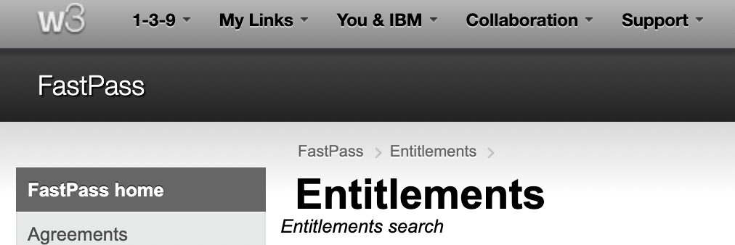

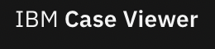
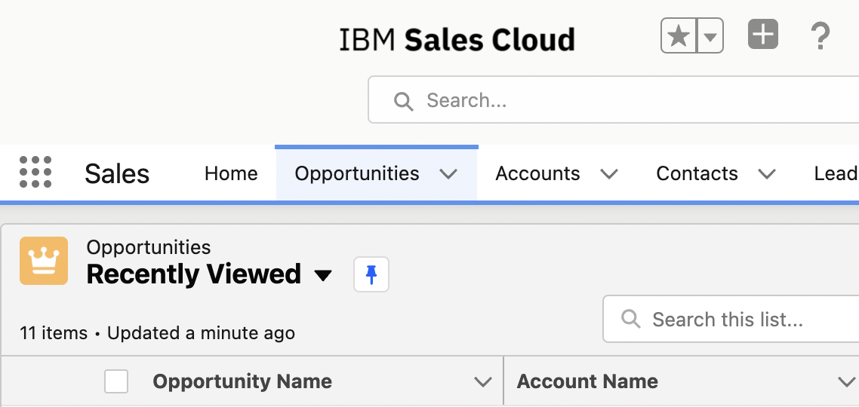

CSM Positioning Enablers
CSM
AWARENESS
CSM
POSITIONING
CSM
ENGAGEMENT
Prerequisites: “Be prepared - Know your customer”
Gather customer’s information: strategy. ecosystem, hybrid cloud journey, architecture, technologies,…
Understand their entitlements, their reality: current support needs/ operational challenges and opportunities for expansion
Guided procedures for CSM Onboarding via CSM Playbook
Customer Entitlements via FastPass (feeding Gainsight)
Cases / Issues overview via Case Viewer
Opportunities via IBM Sales Cloud
More info on CSM Tools of the Trade
All what you need to know to and access via CSM ToolKit
This template helps to engage as a CSM with your customer
IBM Customer Success / © 2022 IBM Corporation

Slide 3


Customer
Logo
Welcome to
IBM Customer Success
Date: dd/mm/yy
Location: XYZ, Country

Slide 4






Customer
Logo
Driving Customer Success at IBM
Your IBM Customer Success Manager is a value-add technical resource to help you achieve your business objectives. Through the deployment of key licensed or subscribed IBM cloud and software offerings, they can help you realise value from your investments on IBM products.
ENABLE BUSINESS INNOVATIONS
ACCELERATE TIME TO VALUE
DELIVER. AGILE SOLUTIONS AT SCALE
CONTINUOUS SUPPORT & CO-INNOVATION
Conduct workshops to identify and validate business-driven use-cases
Help you scale out workloads to production successfully
Escalate issues and marshal resources to eliminate roadblocks
Validate architecture design according to best practices
Coordinate demonstrations for business and technical sponsors & practitioners
Transfer knowledge of best practices for how to use IBM’s technology to yield the best value
Connect you with IBM’s development teams for direct product feedback & roadmap previews
Co-create MVPs and POCs to accelerate time to value
The Customer Success Manager supplements, orchestrates and collaborates with Technical Sales, Support,
Expert Labs, Client Engineering, and the rest of the IBM and Partner ecosystems to deliver a signature client experience.
Notes:
We know already a bit a out you

Slide 5
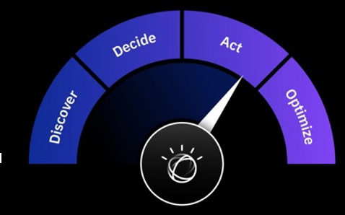

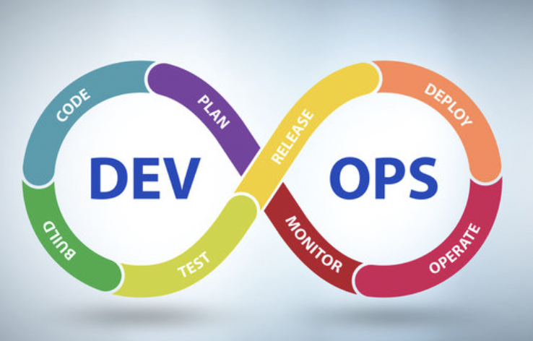
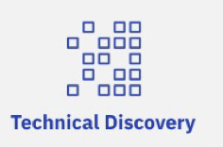
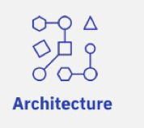

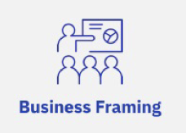

Customer
Logo
Our Engagement Model
ONBOARD
BUILD &
DEPLOY
ADOPT &
IMPLEMENT
SCALE & EXPAND
CONTINUOUS SUPPORT & CO-INNOVATION
Q-GATE
Outcomes
Understanding of your pain points/ challenges and business objectives
List of use cases and prioritization
Definition of success criteria
IBM Enterprise Design Thinking
Outcomes
MVP Architecture
Sign-off for MVP Build
System readiness
Running MVP
Outcomes
Production Architecture
Production Workload
Measurement against MVP
Outcomes
Identification of additionnal deployments opportunities
Qualification of new use cases
Outcomes
Reporting & measurement of success
Demonstration of value out of IBM Cloud Pak offerings
Identification of new use cases enabling s strategic initiatives
Expert Labs
Deployment Architects
Offering Management
IBM Best Practices
(Tech) Sales /
Client Engineering
Support
Notes:
We know already a bit a out you

Slide 6


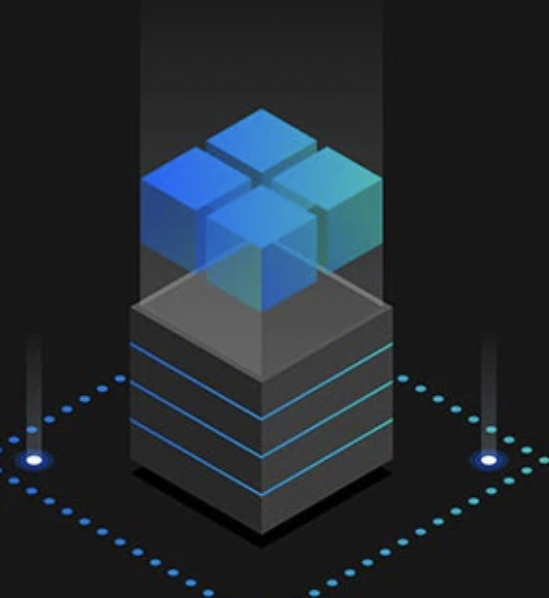
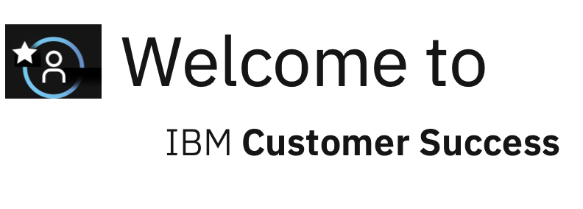

Your Customer Success Manager
A Dedicated Engagement
Customer
Logo
CONNECT & RESONATE
with
TARGET AUDIENCE
Add your
profile pic
☺
Enriching
CUSTOMER EXPERIENCES
Enabling business innovations and
strategic digital transformations
Name Surname
Customer Success Manager
LinkedIn Profile
Add Name,
Surname
& LinkedIn
profile
Accelerating
HYBRID CLOUD & AI JOURNEY
→ …
Describe why you?
How can you
help THEM based on experiences/skills ?
“ TO Be completed”
→…
I am an IBMer dedicated to help you or your business partner succeed and get the most out of your IBM technology.
I will help you at no additional cost.
I can help connect to the right people.
CONNECT with PEOPLE
&
Share something about
You -
Notes:
We know already a bit a out you

Slide 7

Customer
Logo
Our Next Steps | Actions by CSM
Refinement of High-Level Engagement Plan
Schedule a Planning Session to:
Understand your business priorities & challenges and technology plans
Review the entitlements
Evaluate enablers and Cloud Paks deployment options
Establish a High-level roadmap for deployment activities
Agree and prioritize CSM engagement activities
Align on our communication framework - ref. to ELA governance and project(s) meetings
→ + Refine with any other next steps according to CSM positioning session’s outcome
Notes:
We know already a bit a out you

Slide 8
Thank You!
Name Surname
Customer Success Manager
E-mail:
M:
LinkedIn Profile
Add your details

